Slide 1

2022年度後期 進捗報告
Few-shot Biological Information Classification via Reinforced Self-training
東京都立大学 下川原研究室
Shimokawara Lab. Tokyo Metropolitan University
LIU YI
Notes:
Hello, everyone.
Im LIU YI from shimokawara Lab.
Today my presentation title is <Group-level Emotion Classification via Reinforced Self-training>（0：20）

Slide 2
Section1 - Introduction
Background
To help better interaction in VR
To reduce the impact of individual differences, VR surroundings, etc.
To Improve the accuracy of Dialogue Mood recognition in VR
Contactless Virtual Social
become popular in recent years
Smart virtual space/virtual Intelligent Agent
are expected, to help conversation on those online virtual platforms
Few-shot Learning issues in affective Learning
biological information tend to be incomplete, imprecise, inaccurate, noisy supervised
Notes:
Firstly, I will make an briefly introduction about my study,
Background
In recent years, contactless virtual social has become more and more popular 。
On those viirtual platforms, Smart virtual space/virtual interlligent Agent are expected to help better conversation on those online virtual platforms.
For terminology, i'd like to explain what is Dialogue Mood.
Mood is the feeling state of a person usually includes emotions(inner) & atmosphere(outer).
Emotions are mental states caused by neurophysiological changes
while Dialogue Atmosphere is a metric used to describe group-level interactions
which Refers to the feeling brought about by the surrounding in a dialogue（1:10）

Slide 3



Section1 - Introduction
Research Objective
Chat Support Virtual Agent
In Virtual Reality
It's not easy for a player to evaluate other players' emotion and dialogue atmosphere
target problem
1.data balance
2.few-shot problem
3.self-report inaccurate
4.individual problem
Support
Support
VR Interaction
Notes:
Our Research Objective wil be like this
U know, in virtual Reality, it's not easy for a player to evaluate other players' emotion and dialogue atmosphere.
So in order to help better interaction in VR, we need to reduce the impact of individual differences, VR surroundings, etc.
To Improve the accuracy of Dialogue Mood recognition in VR（1:40）

Slide 4

Section2 - Related Work
Few-shot Learning[1]
FSL can be generalized using prior knowledge with supervised information for new tasks that contain only a sample of few-shots
Weakly supervised learning(弱教師あり学習) 、Imbalanced learning(不均衡データ学習 )
Transfer learning(転移学習)、Meta-learning(メタ学習 )
Reinforced Self-Training[4]
Zero-shot Text Classification via Reinforced Self-training(Z Ye et al.,2020) [4]
Reinforcement learning for relation classification from noise data(Feng et al.,2017)[5]
Learning what data to learn(Fan et al.,2017) [6]
[1] Wang Y, Yao Q, Kwok J T, et al. Generalizing from a few examples: A survey on few-shot learning[J]. ACM computing surveys (csur), 2020, 53(3): 1-34.
[2] Kaoru Toyoda, Yoshihiro Miyakoshi, Ryosuke Yamanishi, and Shohei Kato. Dialogue mood estimation focusng on intervals of utterance state. Transactions of the Japanese Society for Artificial Intelligence, 27(2), 2012.
[3] Tatsuya Hasegawa and Shohei Kato. Dialogue mood estimation from speech sounds clusterized with speakers’ personality traits. In 2019 IEEE 8th Global Conference on Consumer Electronics (GCCE), pages 399–401. IEEE, 2019.
[4] Zhiquan Ye, Yuxia Geng, Jiaoyan Chen, Jingmin Chen, Xiaoxiao Xu, SuHang Zheng, Feng Wang, Jun Zhang, and Huajun Chen. 2020. Zero-shot Text Classification via Reinforced Self-training. In Proceedings of the 58th Annual Meeting of the Association for Computational Linguistics, pages 3014–3024, Online. Association for Computational Linguistics.
[5] Feng, J., Huang, M., Zhao, L., Yang, Y., & Zhu, X. (2018). Reinforcement Learning for Relation Classification From Noisy Data. Proceedings of the AAAI Conference on Artificial Intelligence, 32(1). https://doi.org/10.1609/aaai.v32i1.12063
[6] Fan Yang, Tian Fei, Tao Qin, Jiang Bian, and Tie-Yan Liu. Learning what data to learn, arXiv preprint arXiv:1702.08635, 2017.
Notes:
In this section, I will introduce some related work.
Mood engineering, is a theory to study “atmosphere”and people's feelings
DNP has develeoped a “next-generation stealth space”,
which can change the the color of light and music in a room by using sensors to detect people’s presence &conversations and the indoor environment.
In Shohei Kato Lab's research
they researched Dialogue Mood Estimation Focusing on Intervals of Utterance State and considering Personality Trait of Speaker
For Reinforced Self-Training
in this paper,Zero-shot Text Classification via Reinforced Self-training(Z Ye et al.,2020) [4]
proposed a reinforced self-training model for zero-shot learning in NLP
Besides, some studies use Reinforcement learning for better data selection
(2:35)

Slide 5
Section3 - Proposed Model
Reinforced Self-training Model[4]
high-level
labeled dataset
unlabeled
dataset
Train
Predict class
distributions and labels
Classifier
Add to train set
Reward
Evaluation
Predict class
distributions and labels
pseudo labeled dataset
Add selected data
depend on Evaluation
Policy
Network
Perform data selection
via Policy Network
States
*This proposed Model was modified from the Reinforced Self-training model in
<Zero-shot Text Classification via Reinforced Self-training> (Z Ye et al.,2020) [4]
Notes:
This is the proposed Model of my study, this model was modified from the the Reinforced Self-training model in this paper.
We first use high-level/haigh quality labeled dataset to train a class matching model, then we use the matching model to predict unlabeled dataset.
On the other hand, we will train a reinforcement Learning Policy Network to do data selection based on the prediction. and evaluate by validation dataset and get reward to update our policy network.
Based on the perfomance on the validation dataset, we add pesudo labeled instances to our traning dataset and start next traning.
We can also based on the interaction with avater in VR or based on personal biological changes to return the reward to our Policy Network, but this idea needs further verification
（3：40）

Slide 6
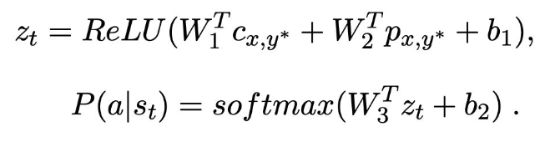
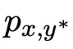
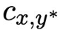
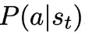
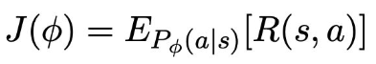
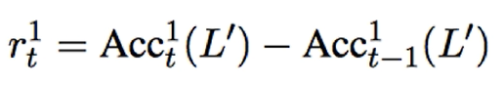
Section3 - Proposed Model
Reinforced Self-training Model[4]
(1)Self-training：
Predict label on unlabeled data
Select samples with high confidence
(2)States:
Prediction confidence
Representation of text
(3)Action:
Select instance or not
(4)Reward:
Train the model on selected data,evaluate on dev set
reward is the change of accuracy
(5)Policy Network:
multi-layer perception(MLP)
Input is State
Output is Action’s probability distribution
(6)Optimization:
*This proposed Model was modified from the Reinforced Self-training model in
<Zero-shot Text Classification via Reinforced Self-training> (Z Ye et al.,2020) [4]
Notes:
This is the proposed Model of my study, this model was modified from the the Reinforced Self-training model in this paper.
We first use high-level/haigh quality labeled dataset to train a class matching model, then we use the matching model to predict unlabeled dataset.
On the other hand, we will train a reinforcement Learning Policy Network to do data selection based on the prediction. and evaluate by validation dataset and get reward to update our policy network.
Based on the perfomance on the validation dataset, we add pesudo labeled instances to our traning dataset and start next traning.
We can also based on the interaction with avater in VR or based on personal biological changes to return the reward to our Policy Network, but this idea needs further verification
（3：40）

Slide 7
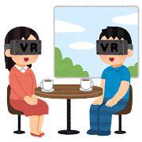

Section4 - Experiment Design
Experiment Setting
APP: VRChat
Group Composition: 2 talkers a group
Participants: more than 20 different groups
Device: VIVE Pro Eye, Polar H10
Details:
(Main talker) wear sensors and VR headset
(Second talker) just login to the VR platform and talk
(Evaluators) will evaluate the dialogue mood via PC/Video
Each conversation lasted approximately 3 minutes
VR&Sensor
PC
communication
Main talker
Second Talker
PC
Evaluators
Notes:
We will conduct our Experiment in VRchat
2 talkers in a group to talk with each other,and we plan to collect more than 20 groups' data.
#We use VIVE Pro Eye and Polar H10 to collect participants's biometric infromation
Main talker will be asked to wear sensors and VR headset.
Second talker just login to the VR platform via PC and talk with Main talker.
Besides, there are serveal Evaluators to evaluate the dialogue atmosphere and Main talkers' emotion.
Main talkers and Second Talkers will also evaluate the dialogue atmosphere and Main talkers' emotion after the experiment.
Each conversation lasted about 3 minutes（4:40）

Slide 8
Section4 - Experiment Design
Raw Data
ECG
Audio
Head tracking
feature extraction
select data
Samples
Train class
Matching Model
Eye tracking
Lip tracking
Experiment schedule
RainRoom
JustRain
ChristmasPark
WaterPark
RelaxRoom
Forest
BloodMemory
GhostMemory
1st experiment (positive group)
in a Relax VR environment
Stay and Relax
Conversation on a particular topic
in a Joy VR environment
Stay and Arouse Joyness
Conversation on a particular topic
2nd experiment (negative group)
in a Sad VR environment
Stay and recall Sadness
Conversation on a particular topic
in a Fear/Disgust VR environment
Play and Experience
Conversation on a particular topic
Arousal
Fear/
Disgust
Joy
Valence
Sad
Relax
Notes:
We will collect ECG, Audio, Head/Eye/Lip Tracking data as Raw Data, and do proper feature extraction to make dataset
and train reinforcement Learning Model to select data automatically.
Our Experiment schedule will be like this.
We will firstly do positive group experiment in Relax/Joy VR World. and second experiment wiil be nagative group in Sad, Fear or Disgust VR world
The four wolrds are correspond to the Arousal-Valnece Coordinate（5:15）

Slide 9
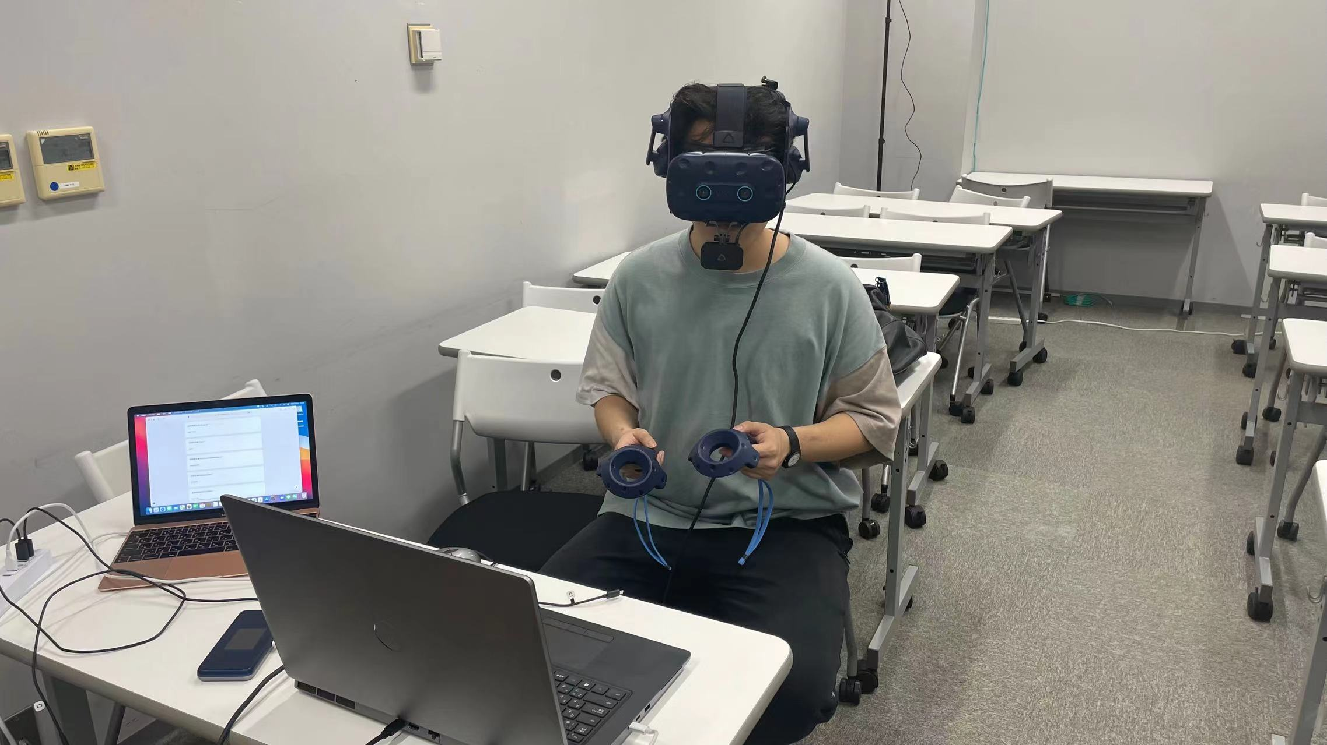
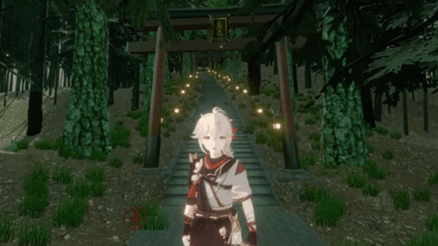
Section4 - Experiment Design
Experiment Images
Enjoy Endless Experience in Virtual Reality
Play & Talk in VRChat
Notes:
This is our Experiment Images
Participants will be asked to wear VR headset , then play& talk in VRchat. Just like this.
Meanwhile, sensors will record biometric data into csv.
Now I have collected data for Six groups.（5：35）

Slide 10
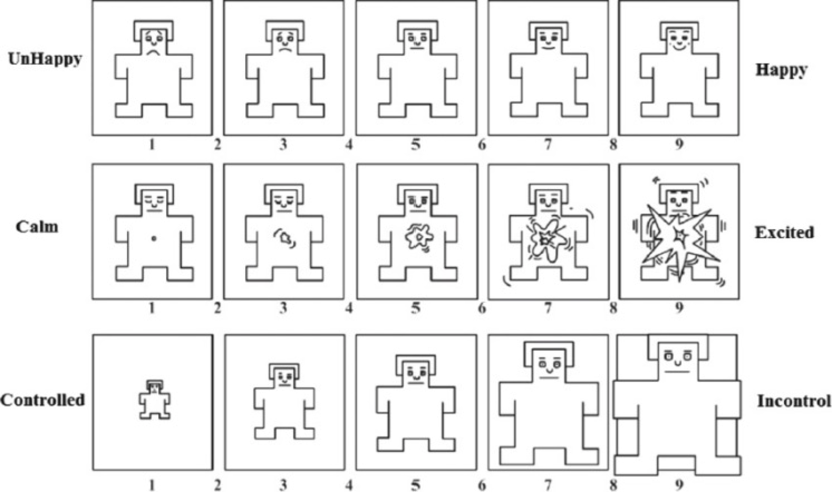
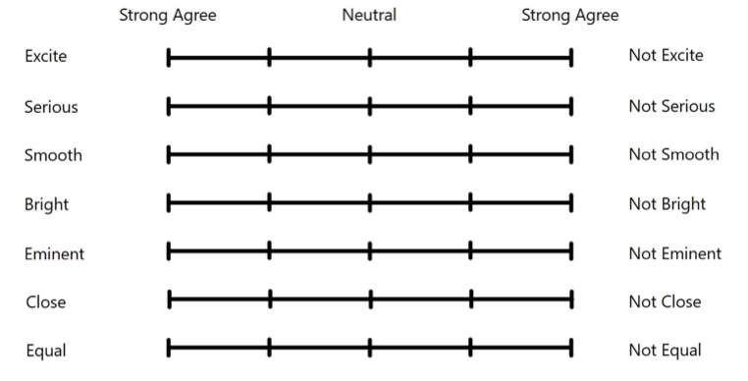
Section4 - Experiment Design
Questionnaire
they will be asked to answer Multidimensional Assessment of Interoceptive Awareness(MAIA) questionnaire to measure multiple dimensions of interoception
Before the Experiment
After the Dialogue
Participants will evaluate the
Dialogue Atmosphere
Evaluate main talkers' emotions by
SAM questionnaire
Notes:
Before the experiment, Participants will be asked to answer MAIA questionnaire to measure multiple dimensions of interoception
After the Dialogue, participants will be asked to evalute main talker's emotions by SAM questionnaire.
They also need to evalute the whole dialogue atmopshere（6:00）

Slide 11
Section5 - Data Analysis
Data Processing
feature extraction
statistical analysis
ECG
HRV
Processed Data
statistical analysis
Eye tracking
Lip tracking
Head tracking
Data Slicing
From 10 participants’ data,
3 minutes of data are sampled every 5 seconds
with each sample being 15s long
Get more than 2000 samples
Notes:
We will collect ECG, Audio, Head/Eye/Lip Tracking data as Raw Data, and do proper feature extraction to make dataset
and train reinforcement Learning Model to select data automatically.
Our Experiment schedule will be like this.
We will firstly do positive group experiment in Relax/Joy VR World. and second experiment wiil be nagative group in Sad, Fear or Disgust VR world
The four wolrds are correspond to the Arousal-Valnece Coordinate（5:15）

Slide 12
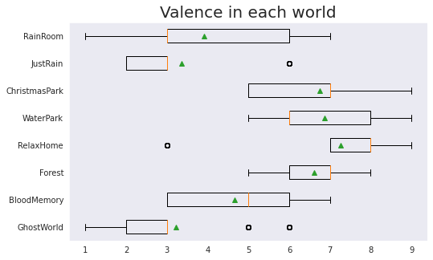
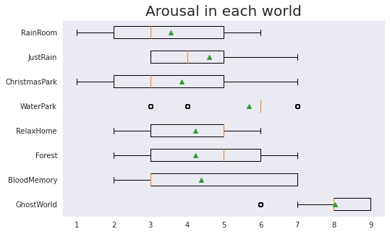
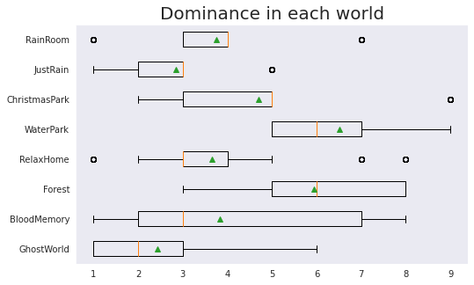
Section5 - Data Analysis
Self-report Analysis
Object | World | Valence | Arousal | Dominance
Depressed | RainRoom | 3.91 | 3.55 | 3.75
Sad | JustRain | 2.56 | 3.87 | 2.19
Pleased | ChristmasPark | 6.76 | 3.86 | 4.69
Happy | WaterPark | 6.88 | 5.68 | 6.52
Relaxed | RelaxRoom | 7.89 | 4.56 | 3.90
Peaceful | Forest | 6.60 | 4.25 | 5.93
Annoyed | BloodMemory | 4.67 | 4.39 | 3.82
Afraid | GhostMemory | 2.49 | 8.07 | 1.90
Notes:
We make a correlation Analysis between HRV/Gaze/Head/Mouth/Lip Movement and Emotion&Atmosphere for each participants
We found individual differences exists in our data.
For example, Some Participants’ Mouth Movement has a greater correlation with Dialogue Mood, but some Participants are not （6:35）

Slide 13
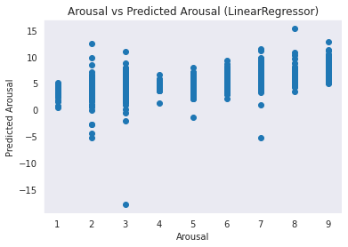
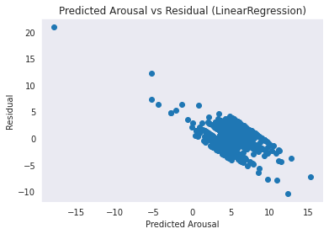
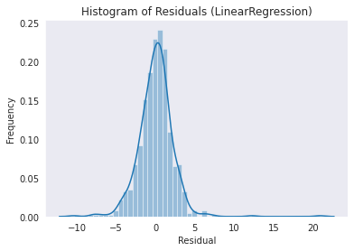
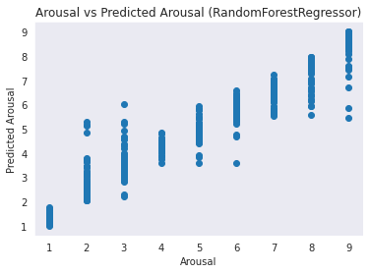
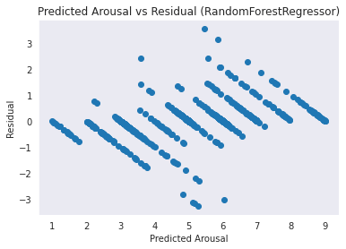
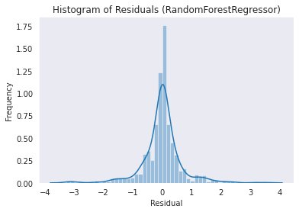
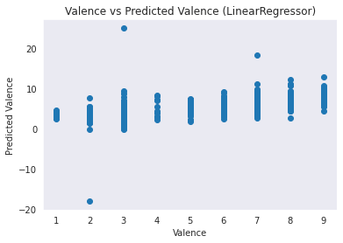
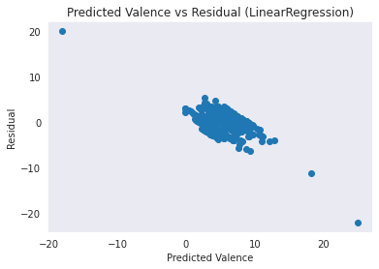
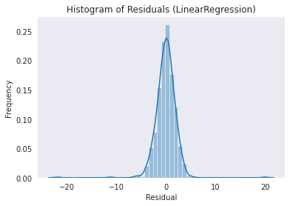
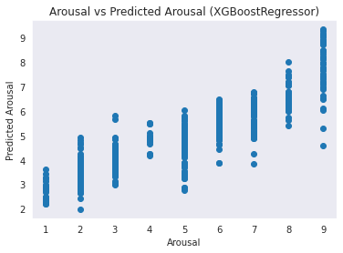
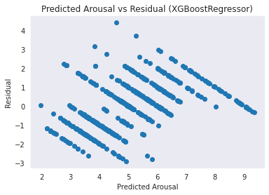
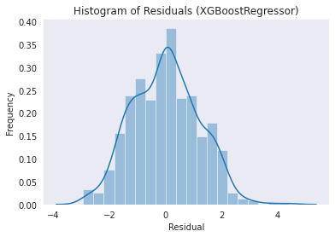
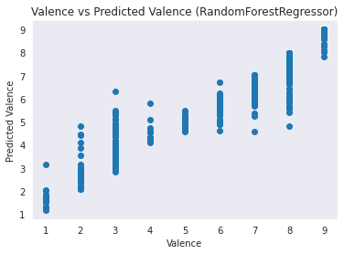
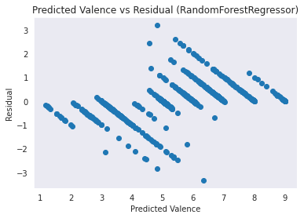
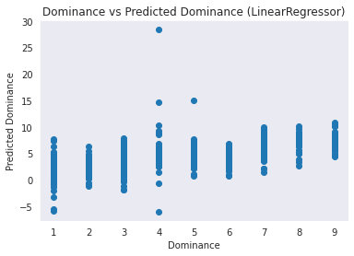
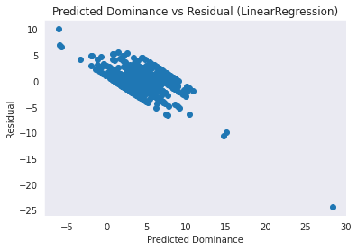
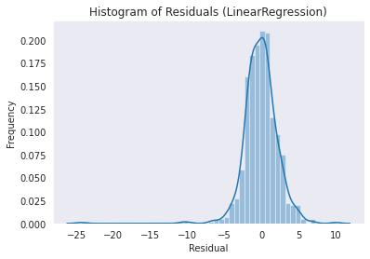
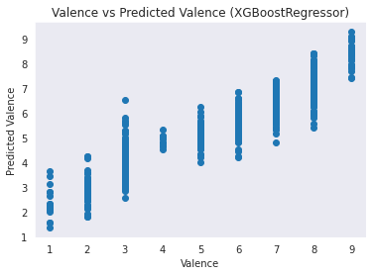
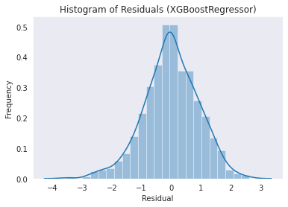
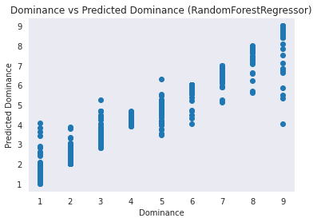
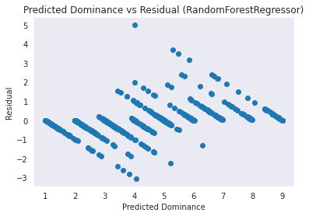
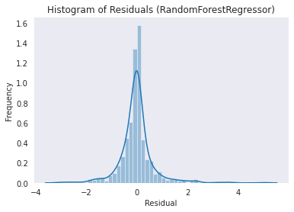
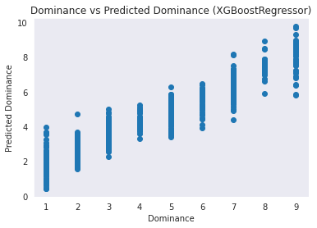
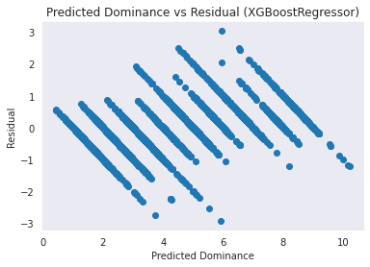
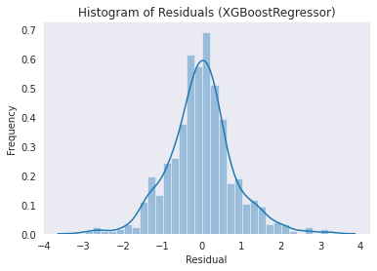
Section5 - Data Analysis
Regression Analysis
Linear Regressor
Arousal
RandomForest Regressor
XGBoost Regressor
Valence
Dominance
Notes:
For Eye Tracking, i also used NNI to extract features of eye movement in both non-dialogue settings and dailogue settings.
We can figure out that in non-dialogue&Dialogue conditions, Sad and Relax have a relatively stable NNI,
while Fear&Disgust has a more fluctuating NNI.（7:00）

Slide 14
Section6- Machine Learning Result
ML Result
Dataset | Size | Classification Goal | SVM-25% |  | SVM-75% |  | SVM+RSL
 |  |  | Acc | G-mean | Acc | G-mean | Acc | G-mean
Kebbi Confidence Dataset | 456 | Confidence(H/M/L) | 0.676 | 0.626 | 0.683 | 0.593 | 0.752 | Todo
VRChat Emotion Dataset2021 | 600 | Valence(HV/LV) | 0.688 | 0.802 | 0.783 | 0.862 | 0.827 | Todo
 |  | Arousal(HA/LA) | 0.675 | 0.790 | 0.771 | 0.848 | 0.767 | Todo
Young Adult's Affective Data(YAAD) set | 399 | Valence(HV/LV) | 0.629 | 0.577 | 0.713 | 0.644 | 0.712 | Todo
 |  | Arousal(HA/LA) | 0.573 | 0.499 | 0.641 | 0.512 | 0.688 | Todo
VRChat Emotion Dataset2022 | 2140 | Valence | 0.712 | 0.828 | 0.796 | 0.881 | Todo | Todo
 |  | Arousal
 |  |  | 0.698 | 0.819 | 0.753 | 0.854 | Todo | Todo
 |  | Dominance | 0.719 | 0.833 | 0.837 | 0.899 | Todo | Todo
Notes:
In the next stage,
we will select high-confidence samples
And Analyze the relation between Self-report&MAIA&Data Distribution
Then we will train Machine Learning Model, to invertigate whether the model is able to draw out individual differences to get a higher score for individuals. （8:00）

Slide 15
Section7 - Future Plan
Future Plan
Visualizing differences in biological information and self-assessment in dialogue/non-dialogue conditions.
Comparing the differences in biological information and self-assessment of different participants in the same VR world environment
Analyze the association between MAIA results and self-assessment
Improve Reinforced Self-Training framework to increase the speed of operation and classification performance for few-shot class
Notes:
Conclusion
A Reinforced Self-training model will be applied to dialogue mood recognition under conversation conditions，
We alter the VR environment to explore the effect of ambience on dialogue mood, as well as the effect on collaborators' assessment.
Our study aims to solve Self-reporting unaccurate, Individual differences, Small sample size problem
Our study expect to verify that data collected from daily conversations could be applied to Reinforced Self-Training
Discussion
I think We can Combine Li'kun's research, to connect Users and other Objects(Avaters/Players) in VR world,
to enjoy a more interesting interaction in VR world.（8:30）

Slide 16
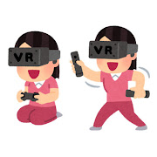
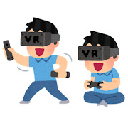
Section8 - Conclusion&Discussion
Conclusion
A Reinforced Self-training model will be applied to dialogue mood recognition
We alter the VR environment and dialogue/nondialogue settings to explore their effect
on dialogue mood as well as the effect on collaborators' assessment.
Our study aims to solve Self-reporting unaccurate, Individual differences, Few-shot problem
Our study expect to verify that data collected from daily conversations could be applied to Reinforced Self-Training
Notes:
Conclusion
A Reinforced Self-training model will be applied to dialogue mood recognition under conversation conditions，
We alter the VR environment to explore the effect of ambience on dialogue mood, as well as the effect on collaborators' assessment.
Our study aims to solve Self-reporting unaccurate, Individual differences, Small sample size problem
Our study expect to verify that data collected from daily conversations could be applied to Reinforced Self-Training
Discussion
I think We can Combine Li'kun's research, to connect Users and other Objects(Avaters/Players) in VR world,
to enjoy a more interesting interaction in VR world.（8:30）

Slide 17
References
References
[1]Wang Y, Yao Q, Kwok J T, et al. Generalizing from a few examples: A survey on few-shot learning[J]. ACM computing surveys (csur), 2020, 53(3): 1-34.
[2] Kaoru Toyoda, Yoshihiro Miyakoshi, Ryosuke Yaman_x0002_ishi, and Shohei Kato. Dialogue mood estimation focus_x0002_ing on intervals of utterance state. Transactions of the Japanese Society for Artificial Intelligence, 27(2), 2012.
[3] Tatsuya Hasegawa and Shohei Kato. Dialogue mood estimation from speech sounds clusterized with speak_x0002_ers’ personality traits. In 2019 IEEE 8th Global Confer_x0002_ence on Consumer Electronics (GCCE), pages 399–401. IEEE, 2019.
[4] Zhiquan Ye, Yuxia Geng, Jiaoyan Chen, Jingmin Chen, Xiaoxiao Xu, SuHang Zheng, Feng Wang, Jun Zhang, and Huajun Chen. 2020. Zero-shot Text Classification via Reinforced Self-training. In Proceedings of the 58th Annual Meeting of the Association for Computational Linguistics, pages 3014–3024, Online. Association for Computational Linguistics.
[5] Feng, J., Huang, M., Zhao, L., Yang, Y., & Zhu, X. (2018). Reinforcement Learning for Relation Classification From Noisy Data. Proceedings of the AAAI Conference on Artificial Intelligence, 32(1). https://doi.org/10.1609/aaai.v32i1.12063
[6] Fan Yang, Tian Fei, Tao Qin, Jiang Bian, and Tie-Yan Liu. Learning what data to learn, arXiv preprint arXiv:1702.08635, 2017.
Notes:
This is my References

Slide 18
ご清聴・ご清視ありがとうございました
Thank you for your kind attention.
Notes:
Thank you for your kind attention。
ご清聴・ご清視ありがとうございました

